Slide 1
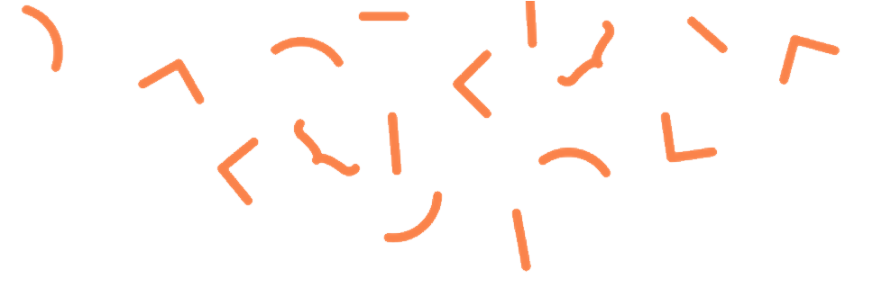
An Introduction to
The Internet and HTML
Notes:
This project was supported by a grant from CIRA's Community Investment Program.

Slide 2
Inspire & Empower
Canadian Children with CODE
We are a Canadian not for profit organization dedicated to empowering kids, teachers and parents with the skills we all need to thrive in a technology driven society.
By teaching kids how to code we teach them how to be better thinkers and better creators in a digital world.

Slide 3
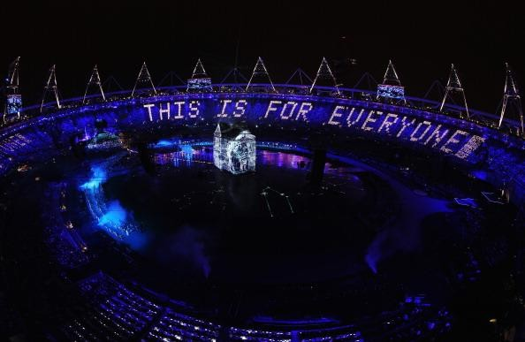
The Internet is Like a City
With a history
London 2012
Olympics
Can anyone name the man in the white box, tweeting
This Is For
Everyone?
Can anyone guess what he’s famous for?
It has Evolved in Stages:
1. Digital inventing
2. Building the Internet
3. Weaving the Web
Notes:
Sitting in that lit up box is a man, Sir Tim Berners-Lee, the inventor of the world web, tweeting that message to the world.
Does anyone know the difference between the Internet and the web.
We’ll talk more about him as we look at stage 3. But the best way to understand the relationship between the Internet and the Web, is to understand a little bit about how we evolved to this place where one man could sit in a box and tweet this multi-media message out to not only the people in the audience, but the world.
The Internet is a lot like a city, and like any city it has an evolution that evolves in roughly 3 stages.

Slide 4
Stage 1
Digital Inventing

Slide 5
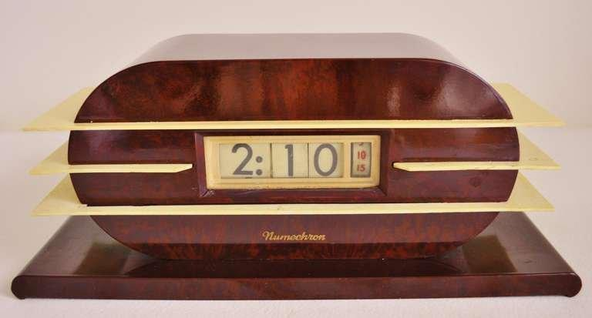
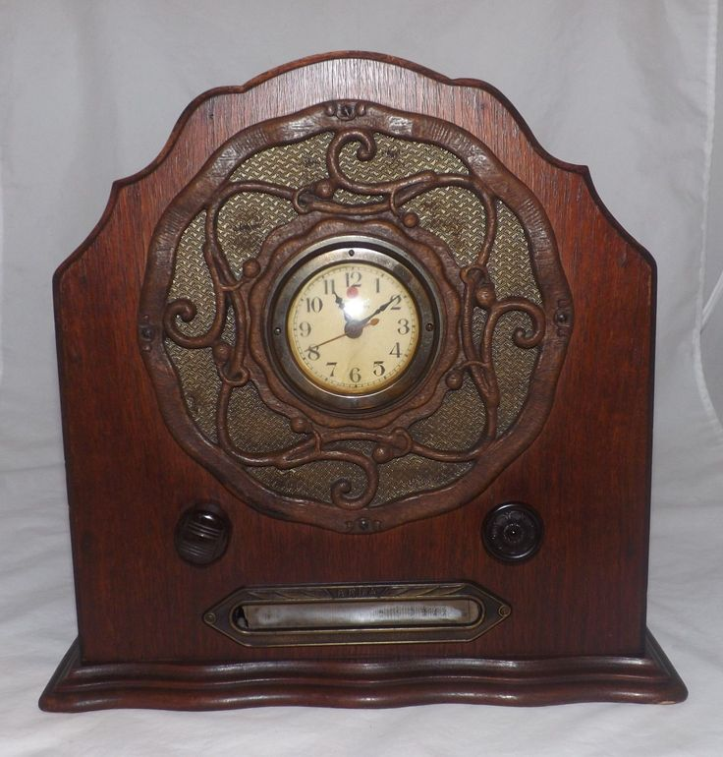
Digital:
Discontinuous bits of information that can be easily shuffled around.
Analog:
Information
is continuous.
Like this clock radio.
Around WW2 scientists started working with digital technology. This creates diverse new ways to communicate information.
Notes:
Digital is different from analog, which means continuous.
It enabled scientist to start playing with many different ways of transmitting information, and essential to creating computers.

Slide 6
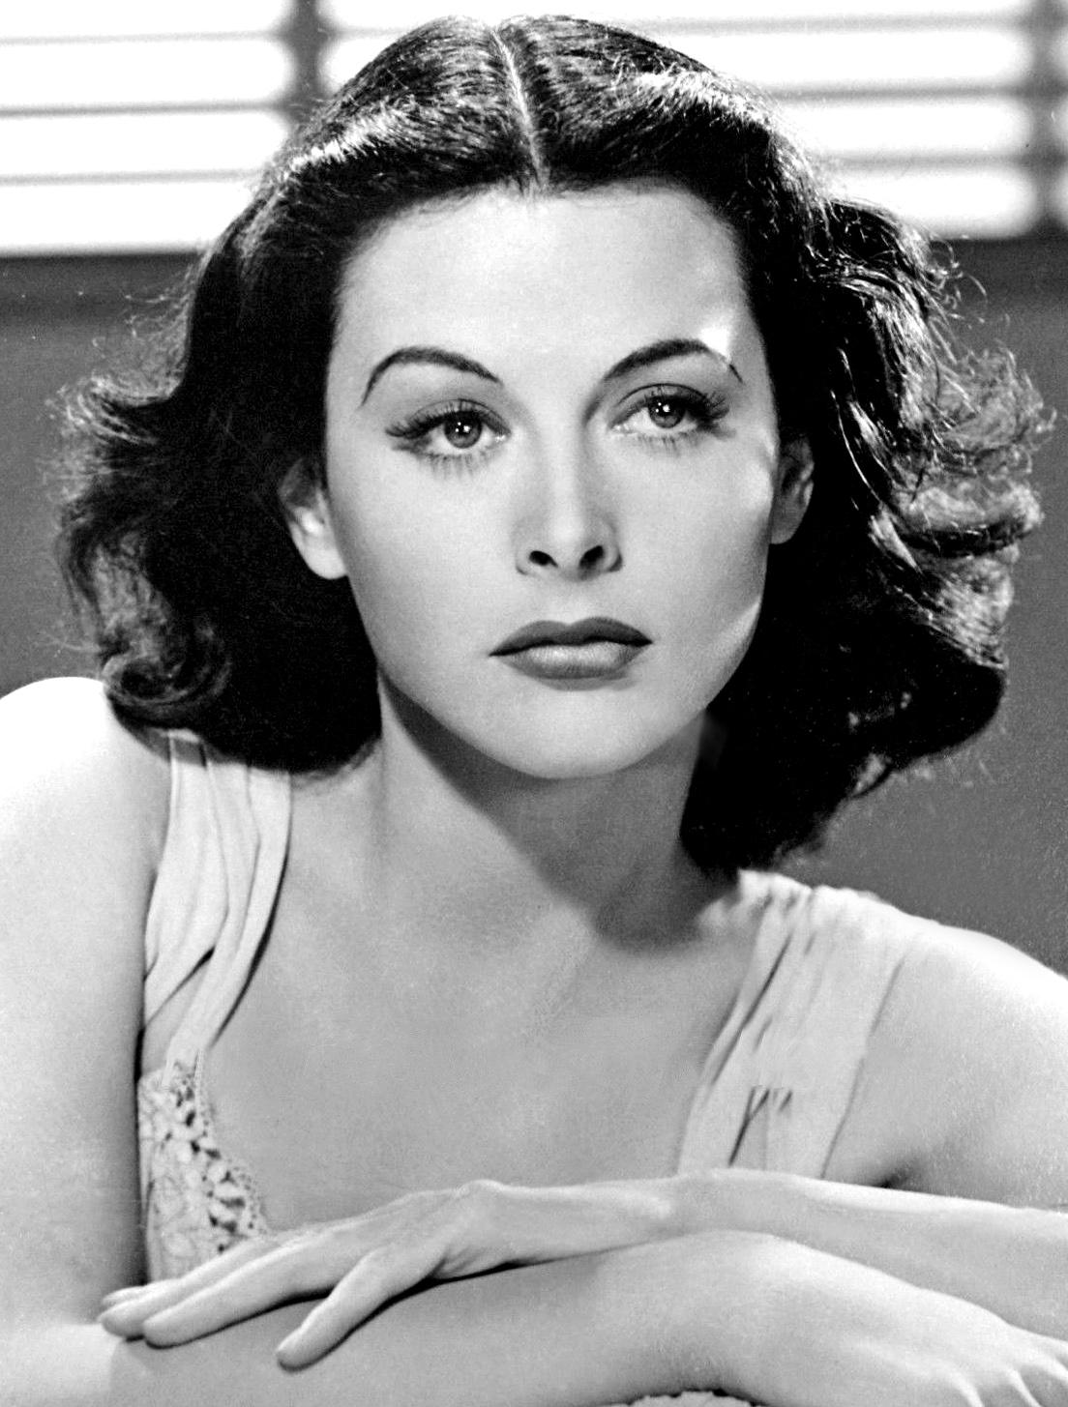
Digital Innovator
Hedy Lamarr:
Mathematician, inventor & Hollywood star
Her Top Secret WW2 “frequency hopper,” evaded enemy decoders.
Her ideas are still used in wireless technologies including Wi-Fi and Bluetooth !
Notes:
Would be great to add this if we want to highlight women who have contributed

Slide 7
Stage 2:
Building The Internet

Slide 8
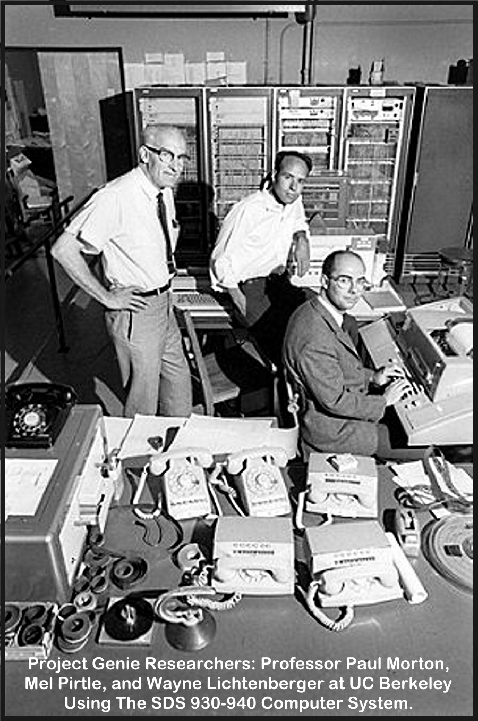
Use of computers and digital data grows in the 60s and 70s.
A huge network of end-to-end computers is built.
There is no central control.
The Internet
Is
HARDWARE
Notes:
“The Internet” is a massive combination of millions of computers, connected via cables and wireless signals.
It is made up of an incredibly large number of independently operated networks: there’s no central control.
These Project Genie Researchers were funded by ARPANET one of the earliest versions of the Internet.

Slide 9
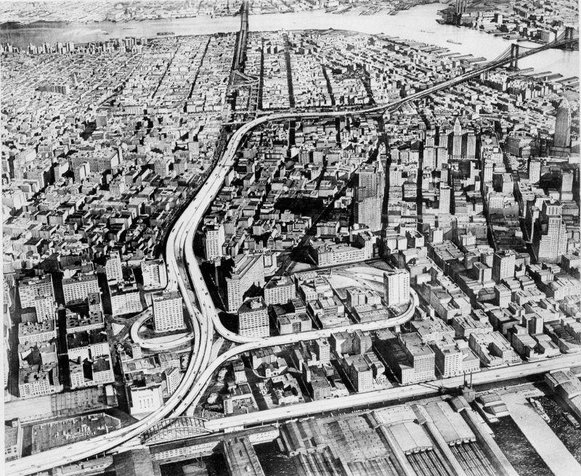
The Internet Grows Like a City
As cities grow they need infrastructure.
Roads, bridges and tunnels.
Notes:
Architectural plan for Lower Manhattan Expressway, which fortunately never happened.

Slide 10
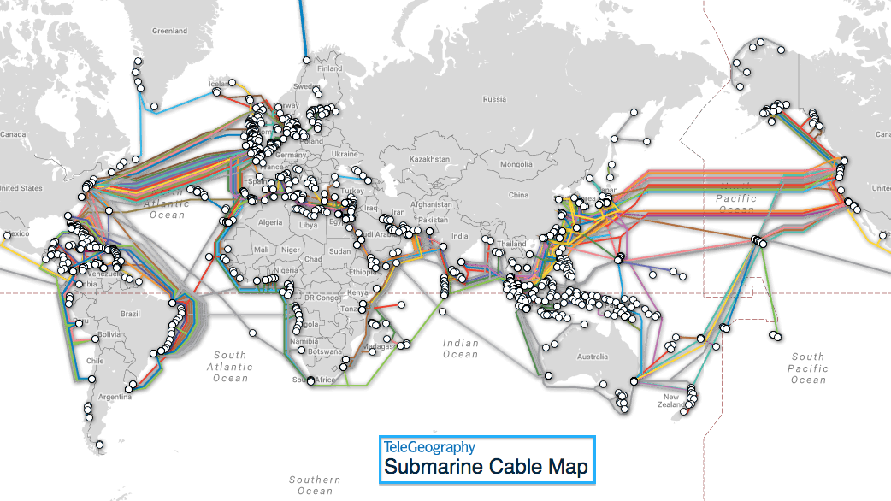
THE INTERNET THAT CONNECTS US
Notes:
The internet is the infrastructure, it’s the cables (the fibre optic or copper wires), the antenna towers that transmit wireless signals, switches and routers that connect together devices from smart thermostats, smart phones, tablets, laptop, to servers, mainframes and data centres.

Slide 11
Stage 3
Weaving the Web

Slide 12
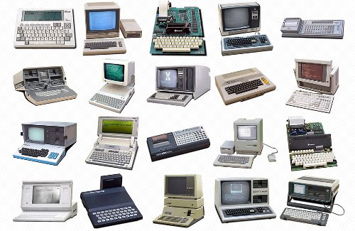
By the 80s There Were so MANY New Computers
Competing software, operating systems and protocols
Collaborating on data becomes very challenging

Slide 13
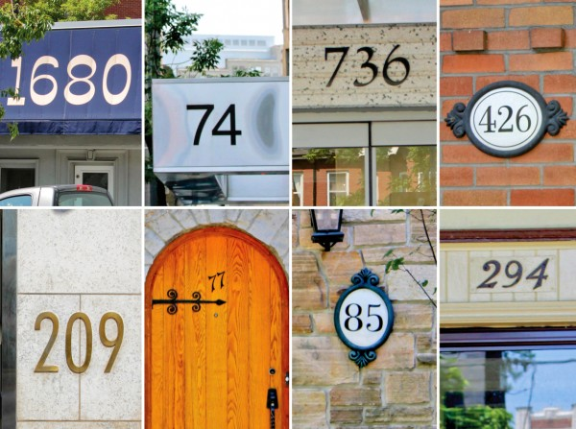
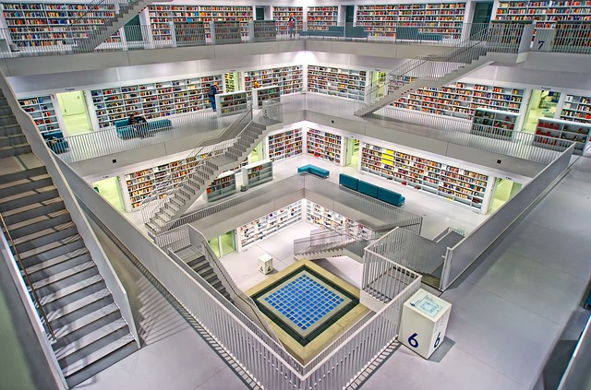
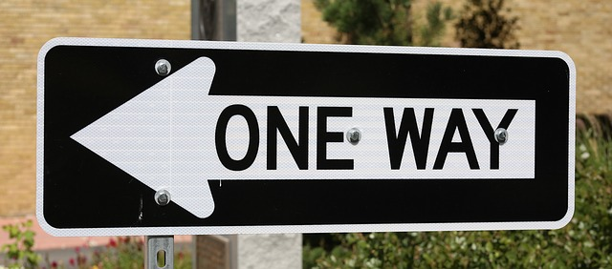
A Growing City Needs Protocols
Location
protocols
Community protocols
Traffic protocols

Slide 14
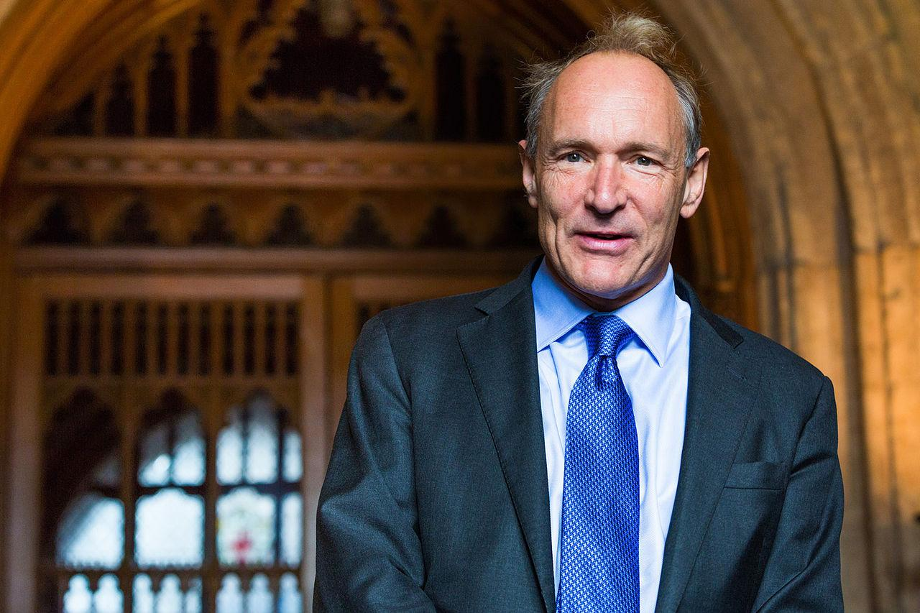
Digital Innovator: Sir Tim Berners-Lee
Late 80s started working at the CERN, a European research centre near Geneva, connecting over a 1000 scientists and engineers from every continent.
CERN needed a system of protocols so that data could be shared.
TimBL (actual nickname) came up with the idea of web pages that would each have an address that would make them easy to link.
(The man in the London Olympics’ box)

Slide 15
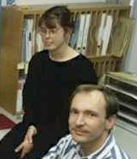
The World Wide Web
1993 the technologies and protocols
behind the WWW
became “open source” so that anyone could use them for free.
Tim Berners Lee with Nicola Pellow, who coded the first line browser
Notes:
The World Wide Web or ‘Web” is the name use for the billions of digital pages written in HTML (Hyper Text Markup Language) code that can be viewed using a web browser (software). Web pages are connected with the programming language HTTP (Hyper Text Transfer Protocol).
The worldwide collection of text pages and multimedia files one can access over the internet. The World Wide Web is now like a global city where it’s easier to find what you are looking for, and easier to be found because everything has an address, a URL (that line at the top of the browser). Information is structured using HTML, so anyone who understands the rudiments of HTML can build their own place and more easily and inexpensively share resources in this city. Learning HTML is a powerful first step towards becoming a more empowered digital citizen.

Slide 16
Anatomy of a Web Address

Slide 17
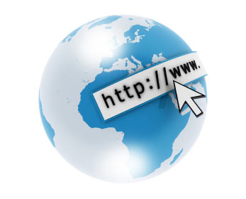
Anatomy of a
Web Address
URL
HTTP
WWW
HTML
Notes:
Write down a web address on the board or highlight the sections as you are explaining them on a smartboard.
URL: The official computer name for a web address; it stands for Universal Resource Locator and (in theory) points to a unique resource on the Web.
HTTP:// stands for Hyper Text Transfer Language
www means World Wide Web and identifies the type of page that will be delivered to the browser window
www.kidscodejeunesse.org = Domain name, indicates which Web server is being requested
HTML “.html” = Hyper Text Markup Language

Slide 18
Digital Citizenship

Slide 19
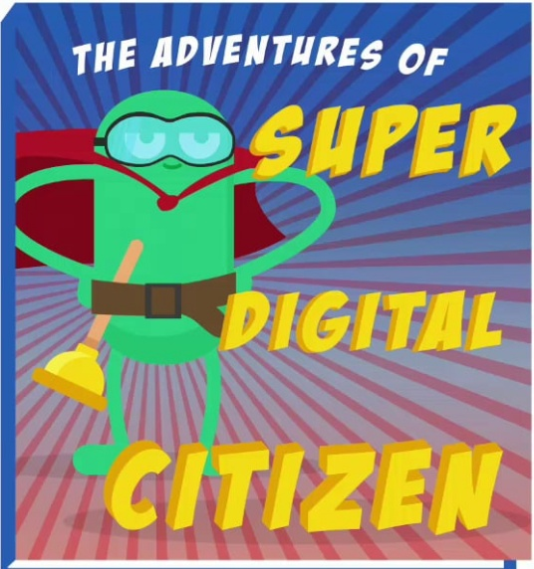
Hyper Text Markup Language
Structures data on web pages.
Learning it can make you a more empowered digital citizen, better equipped for expression, understanding and connection on the world wide web.
h/t common sense media

Slide 20




The Computational
< Planning >
< Collaborating >
< Experimenting >
< Debugging >
<PRACTICES>
Thinker
{CONCEPTS}
{ Algorithms }
{ Decomposition }
{ Pattern Recognition }
{ Abstraction }
{ Logic }
/PERSPECTIVES/
/ Expressing /
/ Understanding /
/ Connecting /
Notes:
This project was supported by a grant from CIRA's Community Investment Program.
Learning HTML has a notable impact on the “Perspectives” section of the computational thinking framework. It can give students and teachers a sense of being a digital “maker,” not a passive user of the web.

Slide 21
HTML
Mad Libs!

Slide 22
<h1> HTML Mad Libs</h1>
HTML Mad Libs
<h3> a fun way to learn about tags</h3>
A fun way to learn about tags
<p>Every student will be given an opening tag or a closing tag. Find your partner(s) and follow
<a href=”https://www.HTMLmadLibs/directions”> these directions </a>. When you’re finished you will have learned the tags for these 5 elements of a web page.</p>
Every student will be given an opening tag or a closing tag. Find your partner (s) and follow these directions. When you’re finished you will have learned the tags for these 5 elements of a web page.
<ol>
<li>headline <li>
<li>paragraph </li>
<li>hyperlink </li>
<li>list type </li>
<li>list item</li>
</ol>
Headline
Paragraph
Hyperlink
List type
List item
Notes:
Would be interesting to add an unplugged activity to this module

Slide 23
Directions
For brainstorming
<h1> teams: 3 headlines
<h3> teams: 3 subheadlines
<p> teams: a paragraph of 3 lines that will include a blank phrase for a link. And end with a blank phrase for a list that might include three items.
<a> teams: one hyperlink with a made up web page address and text that could be clicked in a paragraph.
<ol> or <ul> teams: 3 types of list
<li> teams: 3 items that might go on a list.
Write content and tags down on a piece of paper you can hold up (except for paragraph, which can be read out loud)
Notes:
Instructor might want to provide a few examples. Like “my day” for headline. Or “how I finally learned to love the internet,” as a subheadline

Slide 24
Let’s Put together our Web Page
The way a computer would!
Keep in mind that a computer can only follow directions of HTML tags. I doesn’t “know” when information begins or ends, or whether or not it makes sense.
Computers depend on us to create content that is meaningful to others
Notes:
If instructor has internet access to a live editor it is recommended that elements of the web page are typed in so that teachers/students can see how it would look on an actual web page.
As much as possible Instructor should act like a computer, only following directions given. (For instance if a student forgets to give the <h3> end tag instruction then the headline will bleed into the paragraph .)

Slide 25
Questions? Suggestions? We’d love to hear from you. educators@kidscodejeunesse.org
www.kidscodejeunesse.org

Slide 26

This project was funded by CIRA’s Community Investment Program.

